Slide 1



DIGITAL ASSET MANAGEMENT
YUVASRI S

Slide 2
OVERVIEW
Introduction
Functionalities
Problem
Unit Testing
Objectives
Conclusion
Technology/Tool

Slide 3
INTRODUCTION
This project is designed to manage the lifecycle of digital assets within an organization, including allocation, maintenance, and reservation. Built using Python and MySQL, it ensures efficient tracking and control of assets.

Slide 4
PROBLEM STATEMENT
Organizations often struggle with tracking asset allocation, maintenance schedules, and misuse. This leads to inefficiencies, lost assets, or scheduling conflicts.

Slide 5
OBJECTIVES
To develop a user-friendly application to:
Add and manage assets
Allocate and deallocate assets to employees
Track maintenance history
Handle asset reservations
Generate useful reports

Slide 6
TECHNOLOGIES USED
Programming Language: Python
Database: MySQL
IDE: VS Code
Other Tools: Git

Slide 7
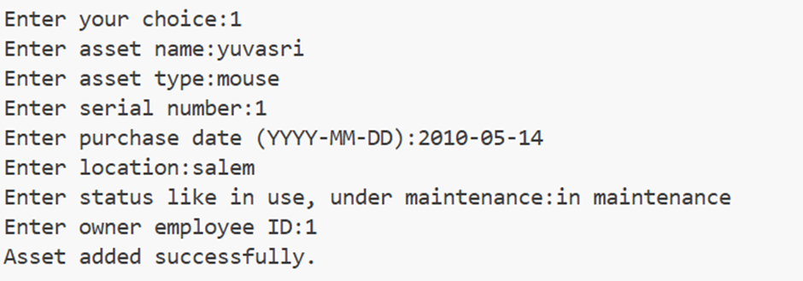
KEY FUNCTIONALITIES
ADD ASSET
Adds a new asset to the system by storing details such as name, type, serial number, location, and owner.
Ensures the asset is associated with a valid employee using a foreign key (owner_id) from the employees table.
OUTPUT:

Slide 8
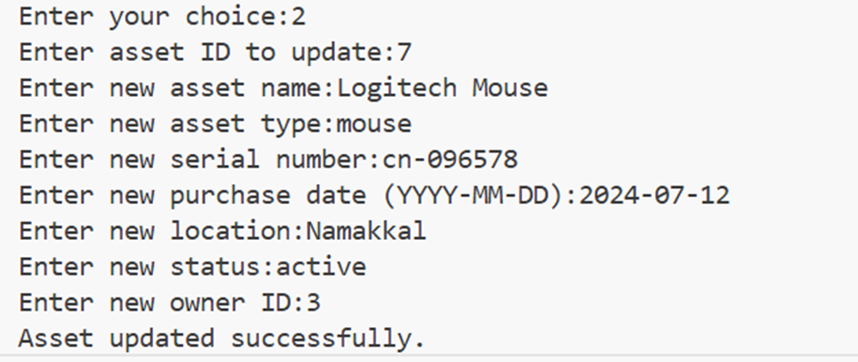

UPDATE ASSET
Allows modification of existing asset details like name, location, or status.
Ensures only valid asset IDs are updated and maintains data consistency
OUTPUT:

Slide 9
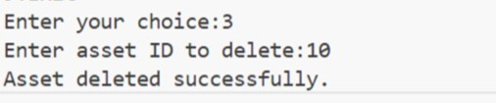
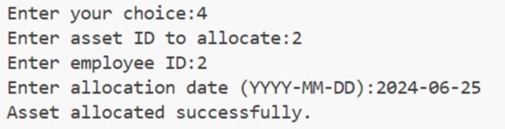
DELETE ASSET
ALLOCATE ASSET
Removes an asset from the system based on its asset ID.
Ensures deletion only occurs if the asset exists and is not currently allocated or reserved.
Assigns an asset to an employee for usage, updating the asset_allocations table.
Records details such as allocation date and ensures the asset is not already allocated.
OUTPUT:

Slide 10
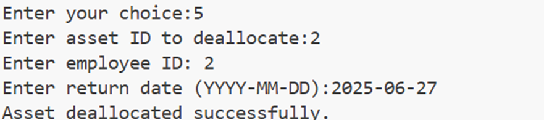
DEALLOCATE ASSET
Releases an allocated asset and updates the return date in the asset_allocations table.
Ensures the deallocation is only done if a valid allocation exists for the asset and employee.
OUTPUT:

Slide 11
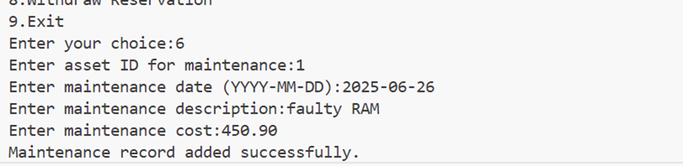
PERFORM MAINTENANCE
Moves an asset into maintenance by adding a record in the maintenance_records table.
Prevents maintenance for assets that are currently allocated or already under maintenance (throws custom exception if invalid).
OUTPUT:

Slide 12
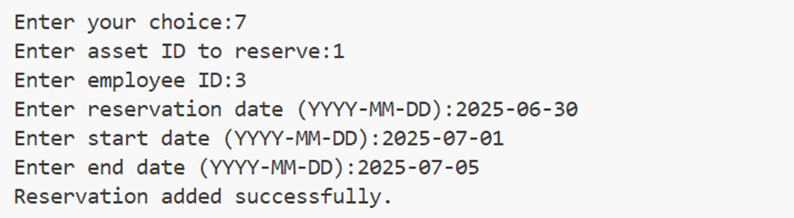
RESERVE ASSET
Allows employees to reserve an asset in advance for future use.
Adds a reservation entry with start and end date in the reservations table, ensuring no conflicts with existing reservations.
OUTPUT:

Slide 13
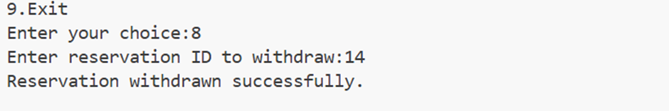
WITHDRAW RESERVATION
Cancels a previously made reservation before its start date.
Ensures only active or upcoming reservations are eligible for withdrawal.
OUTPUT:

Slide 14
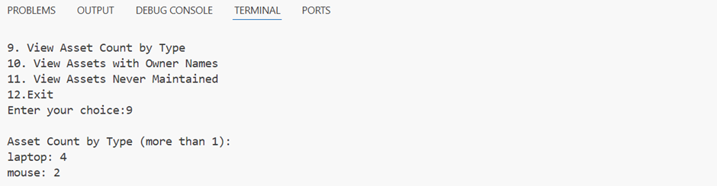
ASSET COUNT BY TYPE
Displays the number of assets grouped by their type (e.g., Laptop, Chair, Projector) using SQL GROUP BY.
Helps in inventory analysis and decision-making for procurement and resource allocation.
OUTPUT:

Slide 15
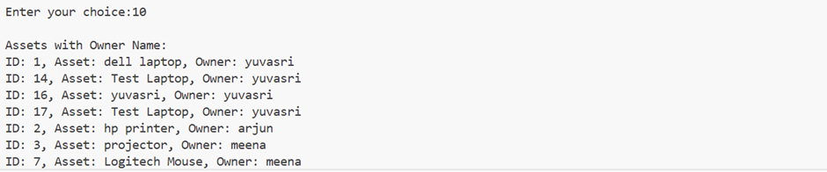
ASSET WITH OWNER NAME
Retrieves asset details along with the associated owner's (employee’s) name using SQL JOIN.
Ensures clear ownership tracking, which aids in accountability and easy communication.
OUTPUT:

Slide 16
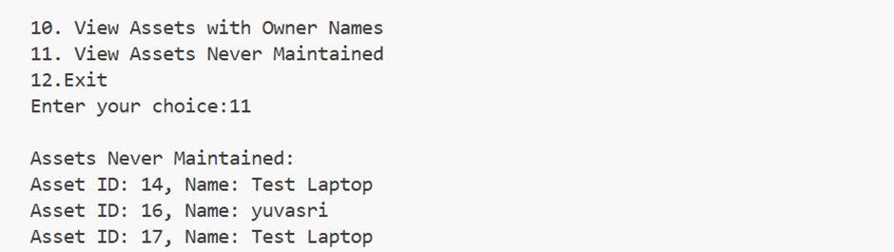
ASSET NEVER MAINTAINED
Lists assets that have never had a maintenance record using LEFT JOIN with NULL check or NOT IN subquery.
Useful to identify overlooked assets and schedule necessary maintenance.
OUTPUT:

Slide 17
EXCEPTION HANDLING
Created specific exceptions like AssetNotFoundException and AssetNotMaintainException that can handle errors when trying to access an asset that doesn’t exist.and trying to view maintenance details for an asset that has never been maintained.
Used to catch unexpected runtime errors, such as database connection failures or invalid user inputs.

Slide 18
UNIT TESTING
Test Case | Functionality Tested | Result
TC001 | Asset Creation | Asset added successfully
TC002 | Add Asset to Maintenance | Maintenance record created
TC003 | Reserve Asset | Asset reserved successfully
TC004 | Exception Handling for Invalid Asset/Emp | Proper exception raised (e.g., AssetNotFoundException)

Slide 19
CONCLUSION
The Digital Asset Management System improves asset control, reduces loss, and increases efficiency in managing digital resources.

Slide 20
Thank You
For your attention

